Slide 1
Title :- “Image Quilting and Texture Synthesizing” Created by:- Raj Koyani -21MIS1017 Aneesh V. – 21MIS1030

Slide 2
Problem Statement:
The task of image quilting involves generating visually coherent and high-quality texture synthesis by stitching together smaller patches from a given set of sample images. However, existing image quilting algorithms face challenges in efficiently and accurately selecting appropriate patches, ensuring seamless blending, and handling complex textures. The problem statement aims to develop an improved image quilting technique that effectively addresses these challenges, resulting in realistic and visually appealing texture synthesis.

Slide 3
Texture synthesis refers to the process of generating new textures that exhibit similar visual characteristics as a given input texture. Current texture synthesis methods encounter difficulties in capturing fine details, preserving global structure, and maintaining realism in the synthesized textures. The problem statement seeks to develop an advanced texture synthesis algorithm that overcomes these limitations, enabling the creation of high-quality synthetic textures that are visually consistent with the input texture and possess rich detail, global coherence, and realistic appearance.

Slide 4
Texture synthesis
This aims to generate new textures that resemble a given source texture.
It is often used to create larger textures from a small sample or to generate variations of existing textures.
The process involves analyzing the statistical properties of the source texture and then procedurally generating new pixels that match those properties.

Slide 5
Image Quilting
Image quilting and texture synthesis are techniques used in computer graphics and computer vision to generate realistic textures or fill in missing regions in images.
The process involves selecting patches from a source texture and placing them in a target region, while ensuring seamless blending with neighboring patches.
Image quilting involves stitching together small patches of textures to create a larger texture. It is often used for texture synthesis and texture transfer tasks.
The objective is to create a visually appealing and creates a image
that displays high resolution.

Slide 6
Process of Image Quilting
Patch selection: Randomly select patches from the source texture that are similar in appearance to the target region.
Overlapping: Place the selected patches in the target region, allowing for some overlap between patches.
Overlap blending: Perform blending or feathering along the overlapping boundaries of the patches to ensure seamless transitions.
Optimization: Adjust the placement and blending of patches to minimize visible artifacts such as discontinuities or repetitive patterns.

Slide 7
Efros & freeman
The algorithm
Very simple
Surprisingly good results
Synthesis is easier than analysis.

Slide 8
Benefits & Uses of Image Quilting
Uses:
Texture Synthesis: Image quilting is used to synthesize textures by combining small patches from an input texture to generate a larger output texture with seamless transitions.
Texture Transfer: It can be used to transfer the texture of one image onto another, which is valuable in various applications like style transfer, image editing, and graphics design.
Texture Sampling: Image quilting can be used to efficiently sample textures from a source image for various purposes in computer graphics.

Slide 9
Benefits:
Seamless Textures: Image quilting ensures that the generated textures are seamless, meaning the transitions between patches are not visible to the human eye. This is important to create realistic and visually appealing results.
Local Adaptation: Image quilting considers the local features of patches during the synthesis process. As a result, it can better preserve the details and structures of the input texture in the output.
Scalability: Image quilting allows for generating textures of arbitrary sizes, making it suitable for various applications that require textures of different resolutions.
Real-Time Performance: Depending on the algorithm used, image quilting can be computationally efficient and can be performed in real-time, making it applicable in interactive applications and video games.

Slide 10
Benefits & Uses of Texture Synthesis
Uses:
Image and Video Compression: Texture synthesis can be used to compress images and videos more efficiently by representing textures with less data.
Computer Graphics: Texture synthesis is widely used in computer graphics for generating realistic textures on 3D models and scenes.
Virtual Reality and Augmented Reality: Texture synthesis plays a crucial role in creating immersive virtual and augmented reality experiences by providing detailed and realistic textures for virtual environments.
Procedural Content Generation: Texture synthesis can be employed in procedural content generation for video games and simulations to create diverse and visually appealing environments.

Slide 11
Benefits:
Realism: Texture synthesis algorithms aim to replicate the appearance of real-world textures, leading to visually convincing results.
Non-Periodic Patterns: Unlike traditional tiling methods, texture synthesis can generate non-periodic patterns that avoid the repetitive look often associated with regular tiling approaches.
Efficiency: Texture synthesis techniques can efficiently generate large amounts of texture data, reducing the storage and memory requirements in various applications.
Artistic Expression: Texture synthesis algorithms can be combined with other techniques to create unique and artistic visual effects in digital art and design.

Slide 12
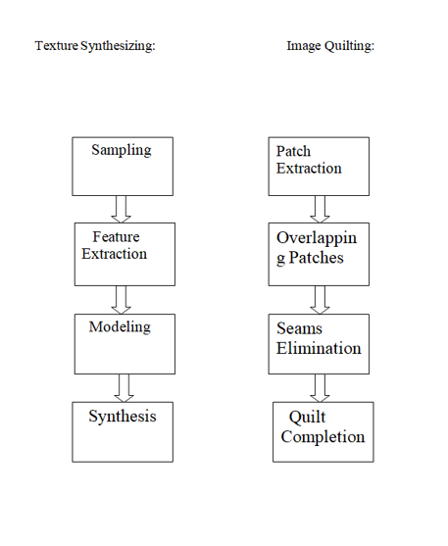
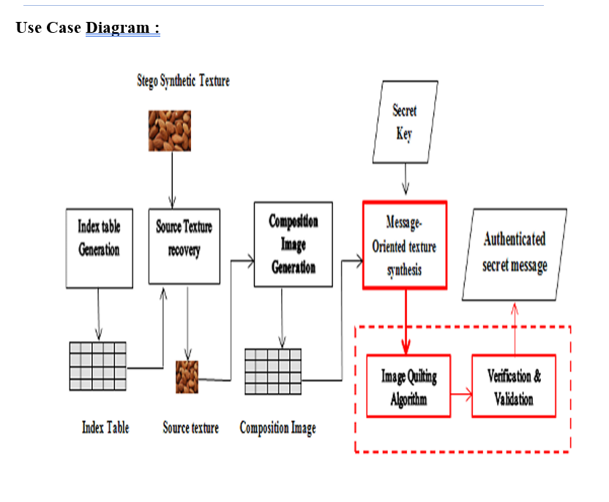

Slide 13
References
Image Quilting in Steganography using Reversible Texture Formation (2017) by Prasad Tanaji Satpute1, Prof. Deipali Gore
“Evaluation of Image Quilting algorithms” by Pepijn van Heiningen (2014)
A.A. Efros and T.K. Leung Texture synthesis by non-parametric sampling (2010)
A.Efros and T.Leung. Texture synthesis by non-parametric sampling. In International Conference for Computer Vision, Vol. 2, pp. 1033-1038, Sep. 1999.
K.Popat and R.Picard. Novel cluster based probability model for texture synthesis, classification and compression. In Visual Communication and Image Processing. Pp. 756-768, 1993.
R.Paget and I Longstaff. Texture synthesis via non-casual nonparametric multi-scale Markov Random Field. IEEE Transactions on Image Processing, 7(6): 925-931, June 1998.
A.Witkin and M.Kass. Reaction-diffusion textures. In Computer Graphics (SIGGRAPH ’91 Proceedings), July 1991.

Slide 14
Literature Survey
Authors & Title of the paper | Type of Study | Tools used | Methodology used | Major Results
J.T.O’Brien, D.S.Wickramanayake, E.A.Edirisinghe, H.E.Bez Image Quilting for Texture Synthesis: A Revisit & A Variation (2003) | Based on the provided information, "Image Quilting for Texture Synthesis: A Revisit & A Variation" appears to be the title of a research paper or academic article. The study type is not explicitly mentioned in the given title, but it is likely to be a revisit and variation of the existing technique of image quilting for texture synthesis. | Programming languages: Researchers commonly use languages like Python, MATLAB, or C++ for implementing algorithms and conducting experiments | In [10] Efros and Freeman proposed a patch based texture synthesis algorithm | It shows a clear improvement as against the synthesized texture obtained with the original algorithm based on the SSD. The synthesized texture obtained with the proposed improvement is more evenly distributed and has no signs of texture repetitions as in the case of using the original algorithm. Accuracy was abt 75%.
Alexei Efros and William T. Freeman Quilting for Texture Synthesis and Transfer (2001-17) | As a research paper, the study is likely to present a detailed analysis of the proposed quilting technique, including its strengths, limitations, and potential applications. It may also compare the results with existing approaches or algorithms in the field. The authors might discuss the underlying concepts, theory, and methodologies employed in their study. | MATLAB was used for implementation. | Patch selection and placement: The algorithm would select patches from the input texture and place them in the output texture image. Patch matching: To ensure visual coherence in the synthesized texture, the algorithm would match and blend the edges of the placed patches. Iterative refinement: The initial placement and matching of patches might not yield. | Despite its simplicity, this method works amazingly well when applied to texture synthesis, producing results that are equal or better than the state-of-the-art [3] but at a fraction of the computational cost. We have also extended our method to texture transfer in a general setting (something that, to our knowledge, has not been done before) with some very promising results. Accuracy was abt 85%

Slide 15
Authors & Title of the paper | Type of Study | Tools used | Methodology used | Major Results
Afrin Fathima*1, Shoby Sunny*2 IMAGE QUILTING ALGORITHM FOR TEXTURE SYNTHESIS (2021) | The sequential spot based algorithm includes steps like initialization, patch selection, calculation of minimum error margins and the blending method along the margins. The approach for stitching a fresh patch in the sequentially created output texture to eliminate discontinuities as much as feasible is the method's key . | Matlabs is used to serve the purpose. | In [10] Efros and Freeman proposed a patch based texture | The number of neurons is 9, number of hidden layers is 1 and total number of layers is 2 with 3 clock cycles.
Prasad Tanaji Satpute1, Prof. Deipali Gore2“ Image Quilting in Steganography using Reversible Texture Formation (2017) | Hardware based circuit is constructed by utilizing the features of covolution neural network and that circuit is also tested for fault free method which helped in smoothing of texture streaming. | Libraries and frameworks: OpenCV, TensorFlow, PyTorch, and scikit-image are commonly used libraries for computer vision and image processing tasks. | The Imaging sensor-FPGA combination is used. | Efros and Freeman to partially parallelize the approach, allowing for significant speedups when using multi-core systems. Efros and Freeman's approach can be improved further by removing persistent junk effects and noise in the visual results, as well as expanding the spectrum of input textures on which the code can work. Accuracy was abt 82%
Pepijn van Heiningen “Evaluation of Image Quilting algorithms” (2014) | Neural networks can be ”trained” to solve problems that are difficult to solve by conventional computer algorithms. . | The design tool used is Xilinx spartan-6. | Statistical and mathematical tools: Researchers often employ statistical analysis and mathematical modeling techniques | If we look at texture synthesis, selecting the best block produces similar results compared to select- ing a random block within a margin.

Slide 16
Authors & Title | Type of Study | Tools used | Methodology used | Major Results
A.A. Efros and T.K. Leung Texture synthesis by non-parametric sampling (2010) | To gain a comprehensive understanding of the study's tools, methodology, and results, it would be necessary to refer to the research multiresolution strategy. | However, based on the publication date in 2010, it is likely that the authors employed programming languages such as MATLAB or C++ along with relevant libraries | The methodology used in the study is centered around non-parametric sampling for texture synthesis. Non-parametric sampling refers to a technique where patches or regions from an input texture are sampled and then used to generate a larger synthesized texture. The authors likely proposed an algorithm or approach that leverages non-parametric sampling for texture synthesis. | As for the results, without access to the specific research paper, it is not possible to provide a detailed account of the outcomes. However, the study likely presents the results of their experiments and evaluations. Accuracy was abt 81.7%.
Vladimir V. Gurenko, Vyacheslav A. Eliseev,Maxim O. Usmanov Analysis of Texture Synthesis Algorithms in Computer Graphics (2022) | Hardware based circuit is constructed by utilizing the features of neural network and that circuit is also tested for fault free method. | MATLAB or C++ along with relevant libraries | The methodology might include implementing and running different texture synthesis algorithms on various datasets to assess their efficiency, visual quality, and computational requirements. | The study likely presents the findings of the analysis conducted by the authors. This may include a comprehensive comparison of different texture synthesis algorithms, discussing their advantages and disadvantages, and potentially identifying trends or patterns in their performance.
A survey on texture synthesis and its approaches “P. Malathi,N.V. Shibu,P. Malathi” (2016) | Neural networks can be ”trained” to solve problems that are difficult to solve by conventional computer algorithms. | However, in survey papers, authors generally rely on literature review and analysis | ANN with 3 layers is used. Which contains higher resolution combination is used. | Floating point bit precision was not achieved.

Slide 17
Authors & Title of the paper | Type of Study | Tools used | Methodology used | Major Results
Wei Xin; Jiang Huawei; Yang Teng fei study on constraint-based texture synthesis (2010) | This paper emphasizes on the idea of implementation of neural networks using FPGAs. The resultant neural networks are modular, compact. | However, since the study focuses on constraint-based texture synthesis, the authors might have employed programming languages such as MATLAB or C++, along with relevant libraries and frameworks commonly used in image processing and computer graphics. | The methodology might involve formulating the constraints mathematically and incorporating them into the texture synthesis algorithm. | The results may also include visual comparisons or quantitative evaluations to demonstrate the effectiveness of the constraint-based approach..
Gang Liu; Yann Gousseau; Gui-Song Xia Texture synthesis through convolutional neural networks and spectrum constraints (2016) | The study focuses on texture synthesis and proposes a method that combines convolutional neural networks (CNNs) with spectrum constraints. CNNs are a type of deep learning architecture commonly used for image analysis and processing tasks. Spectrum constraints refer to imposing constraints on the frequency spectrum of synthesized textures. | MATLAB or C++, along with relevant libraries | Training a CNN: Texture synthesis with spectrum constraints: Evaluation and analysis: | This may include examples of synthesized textures, comparisons with other methods, and discussions on the advantages and limitations of their approach.Accuracy was about 78%.

Slide 18
Conclusion
Image quilting is a technique that revolutionizes the process of texture synthesis by combining small patches of existing textures to create new ones. It has gained significant attention in computer graphics, computer vision, and image processing due to its ability to generate visually appealing and realistic textures. The technique offers several advantages and applications in different fields.
In the realm of video games and virtual environments, image quilting allows developers to generate diverse and visually captivating textures for objects, terrains, and environments. By synthesizing textures based on existing samples, they can create immersive game worlds that enhance the overall gaming experience.

Slide 19
Augmented reality applications also benefit from image quilting. By synthesizing textures that match the surrounding real-world environment, virtual objects seamlessly blend with the scene, appearing more realistic and integrated. This enhances the illusion of virtual objects coexisting with the real world.
In the domain of movies and animations, image quilting plays a crucial role in creating visual effects. Artists can use this technique to generate detailed and coherent textures for various elements like characters, creatures, and environments. The result is visually stunning effects that captivate the audience and enhance the overall visual quality of the production.
Image quilting finds applications in image editing and artistic rendering as well. It enables texture transfer and style transfer, allowing the texture of one image to be applied to another. This facilitates the creation of artistic effects and enables the generation of images with textures inspired by specific references.
Furthermore, image quilting assists in image inpainting and restoration. When there are missing or damaged regions in an image, the technique can synthesize textures from the surrounding areas to fill in the gaps. This helps in restoring the image's visual coherence and produces a more complete representation.

Slide 20
Lastly, image quilting is valuable in the field of 3D modeling. It enables the generation of textures for 3D models, such as buildings, vehicles, or objects. By synthesizing textures based on existing samples, it allows the creation of realistic and visually appealing textures that enhance the overall quality of the 3D models.
Overall, image quilting for texture synthesis offers flexibility, versatility, and realistic results across various applications. Its ability to seamlessly blend textures, transfer styles, inpaint missing regions, and generate visually appealing textures makes it an invaluable tool in fields that rely on high-quality texture synthesis. Through its continued development and utilization, image quilting contributes to advancements in computer graphics, computer vision, and image processing, pushing the boundaries of what is possible in texture.

Slide 21
Thank You

